Slide 1
Web development (Introduction to HTML)

Slide 2
HTML
Hyper Text Markup Language
Most widely used language on Web to develop web pages
HTML was created by Berners-Lee in late 1991
HTML 2.0 was the first standard HTML specification published in 1995.
HTML 4.01 was a major version of HTML published in late 1999.
Currently we are having HTML-5 version which is an extension to HTML 4.01, published in 2012.

Slide 3
Hyper Text Markup Language
Hypertext refers to the way in which Web pages (HTML documents) are linked together. Thus, the link available on a webpage is called Hypertext.
Hypertext is text which contains links to other texts
HTML is a Markup Language which means you use HTML to simply "mark-up" a text document with tags that tell a Web browser how to structure it to display.

Slide 4
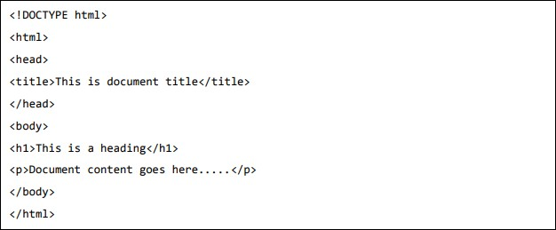
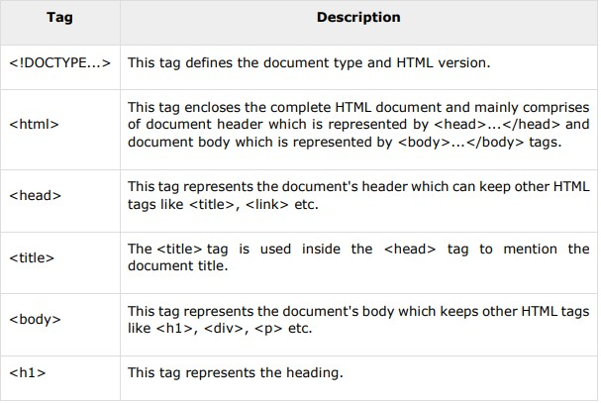
Basic HTML Document

Slide 5
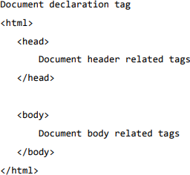
HTML Tags
tags are enclosed within angle braces <Tag Name>.
most of the tags have their corresponding closing tags.
<html></html>
<body></body>
HTML Document Structure

Slide 6
HTML – BASIC TAGS
Heading Tags <h1>…….. <h6>
Paragraph Tag <p></p>
Line Break Tag <br />
This tag is an example of an empty element, where you do not need opening and closing tags, as there is nothing to go in between them.
Centering Content <center> </center>

Slide 7

HTML Element
An element in HTML represents some kind of structure or semantics and generally consists of a start tag, content, and an end tag.

Slide 8
HTML – ATTRIBUTES
An attribute is used to define the characteristics of an HTML element and is placed inside the element's opening tag. All attributes are made up of two parts: a name and a value:
The name is the property you want to set. For example, the paragraph element in the example carries an attribute whose name is align, which you can use to indicate the alignment of paragraph on the page.
The value is what you want the value of the property to be set and always put within quotations.

Slide 9
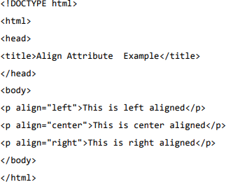
The below example shows three possible values of align attribute:
left, center and right.

Slide 10
HTML Formatting
Bold <b></b>
Italic <i></i>
<u></u>
<big></big>
<small></small>
<sub> </sub>
<sup> </sup>

Slide 11
HTML phrase tags
<em>
<mark>
<strong>
<blockquote>
Short quotations <q>
<code>

Slide 12
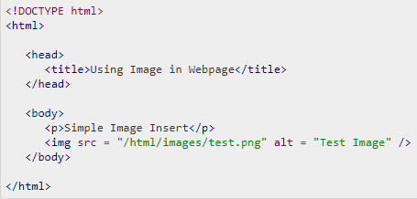
HTML Images
Images in Web page

Slide 13
HTML Tables
The HTML tables are created using the <table> tag in which the
<tr> tag is used to create table rows
<td> tag is used to create data cells. The elements under <td> are regular and left aligned by default.
Table heading can be defined using <th> tag.
Cell Padding
The distance between cell borders and the content within a cell.
Cell Spacing
Space between table cells.

Slide 14
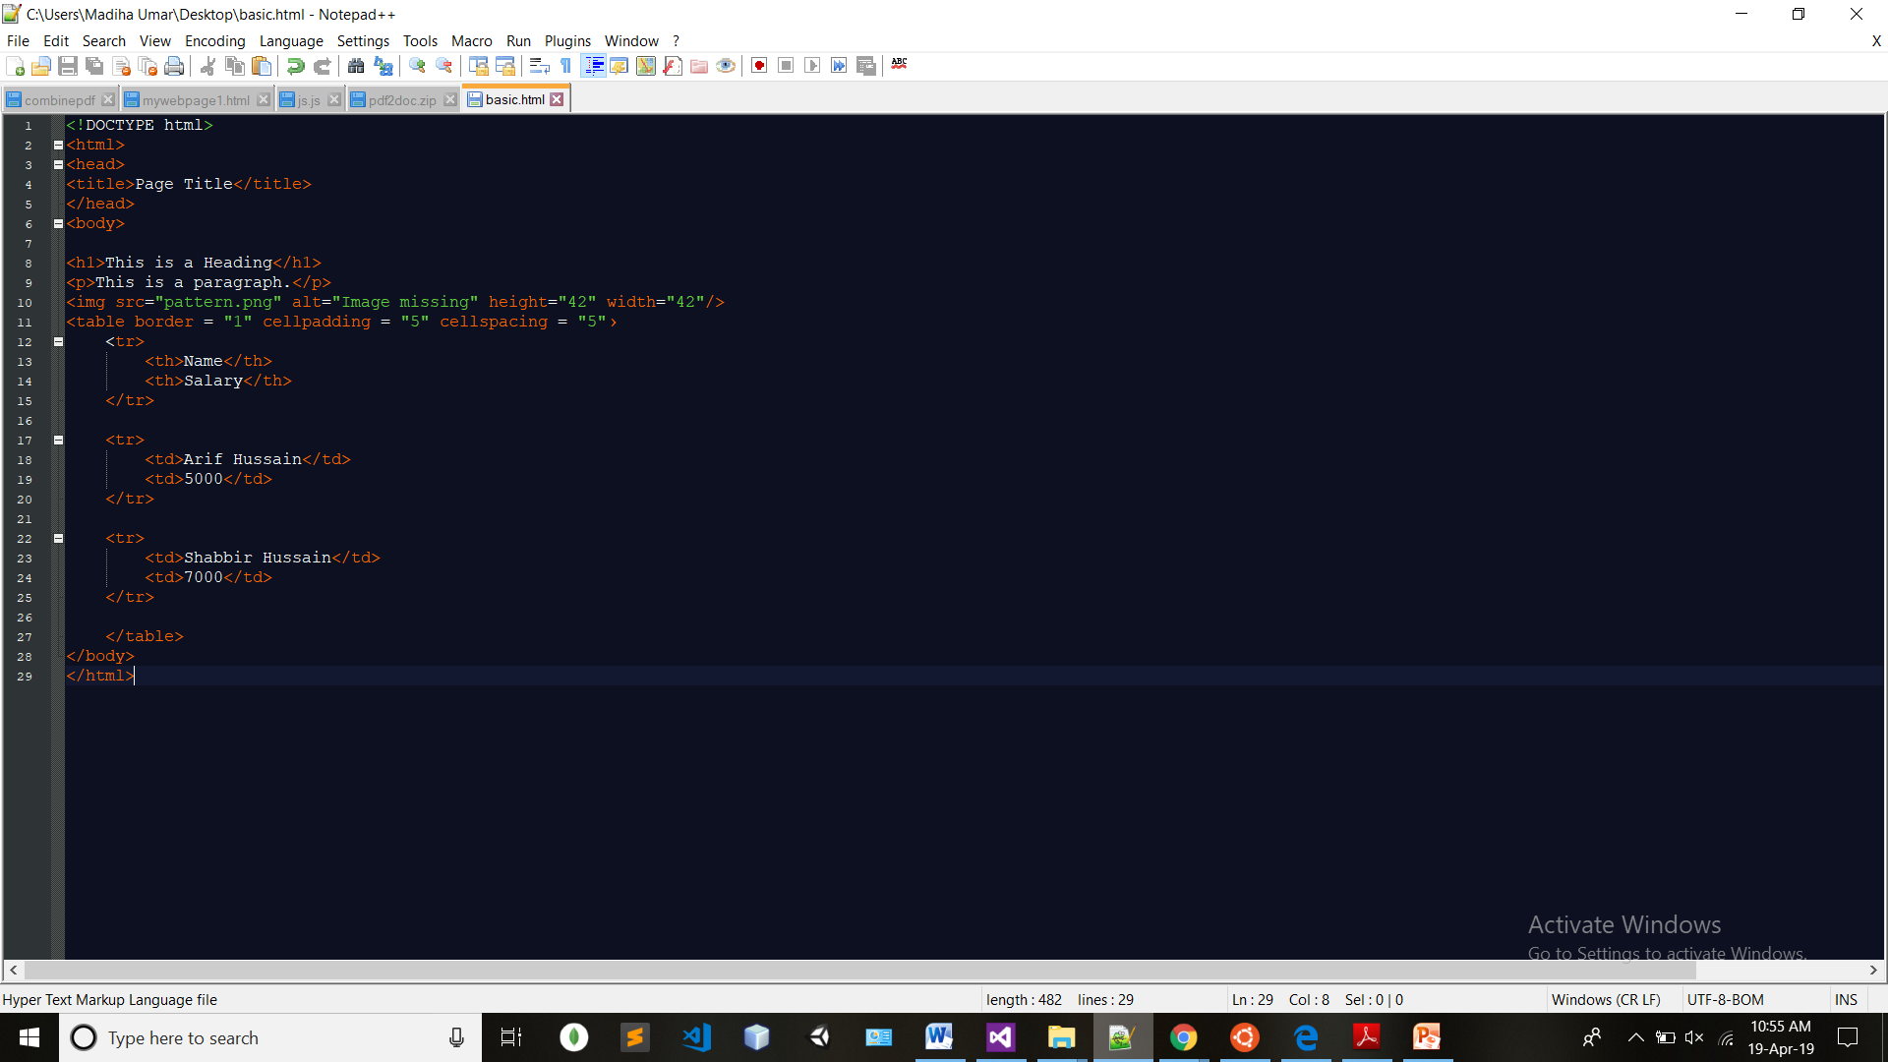
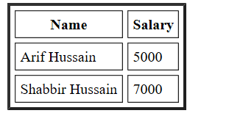
Exercise

Slide 15
Rowspan Colspan?

Slide 16
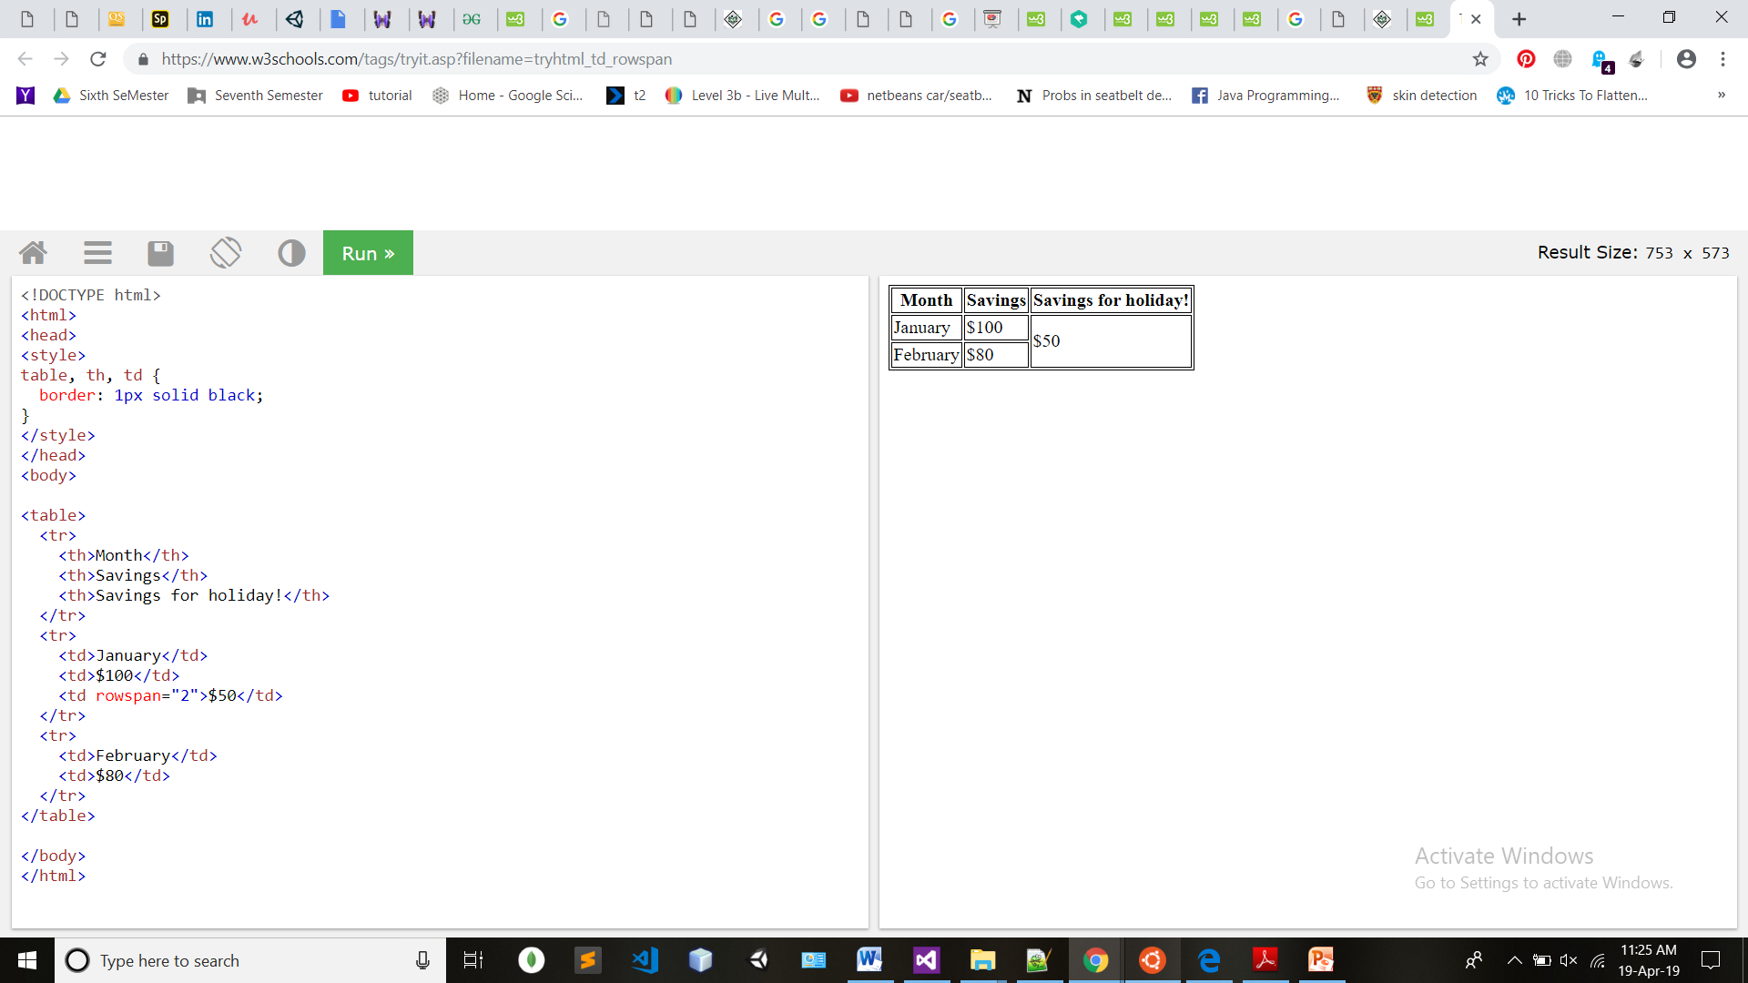
Exercise (Rowspan)

Slide 17
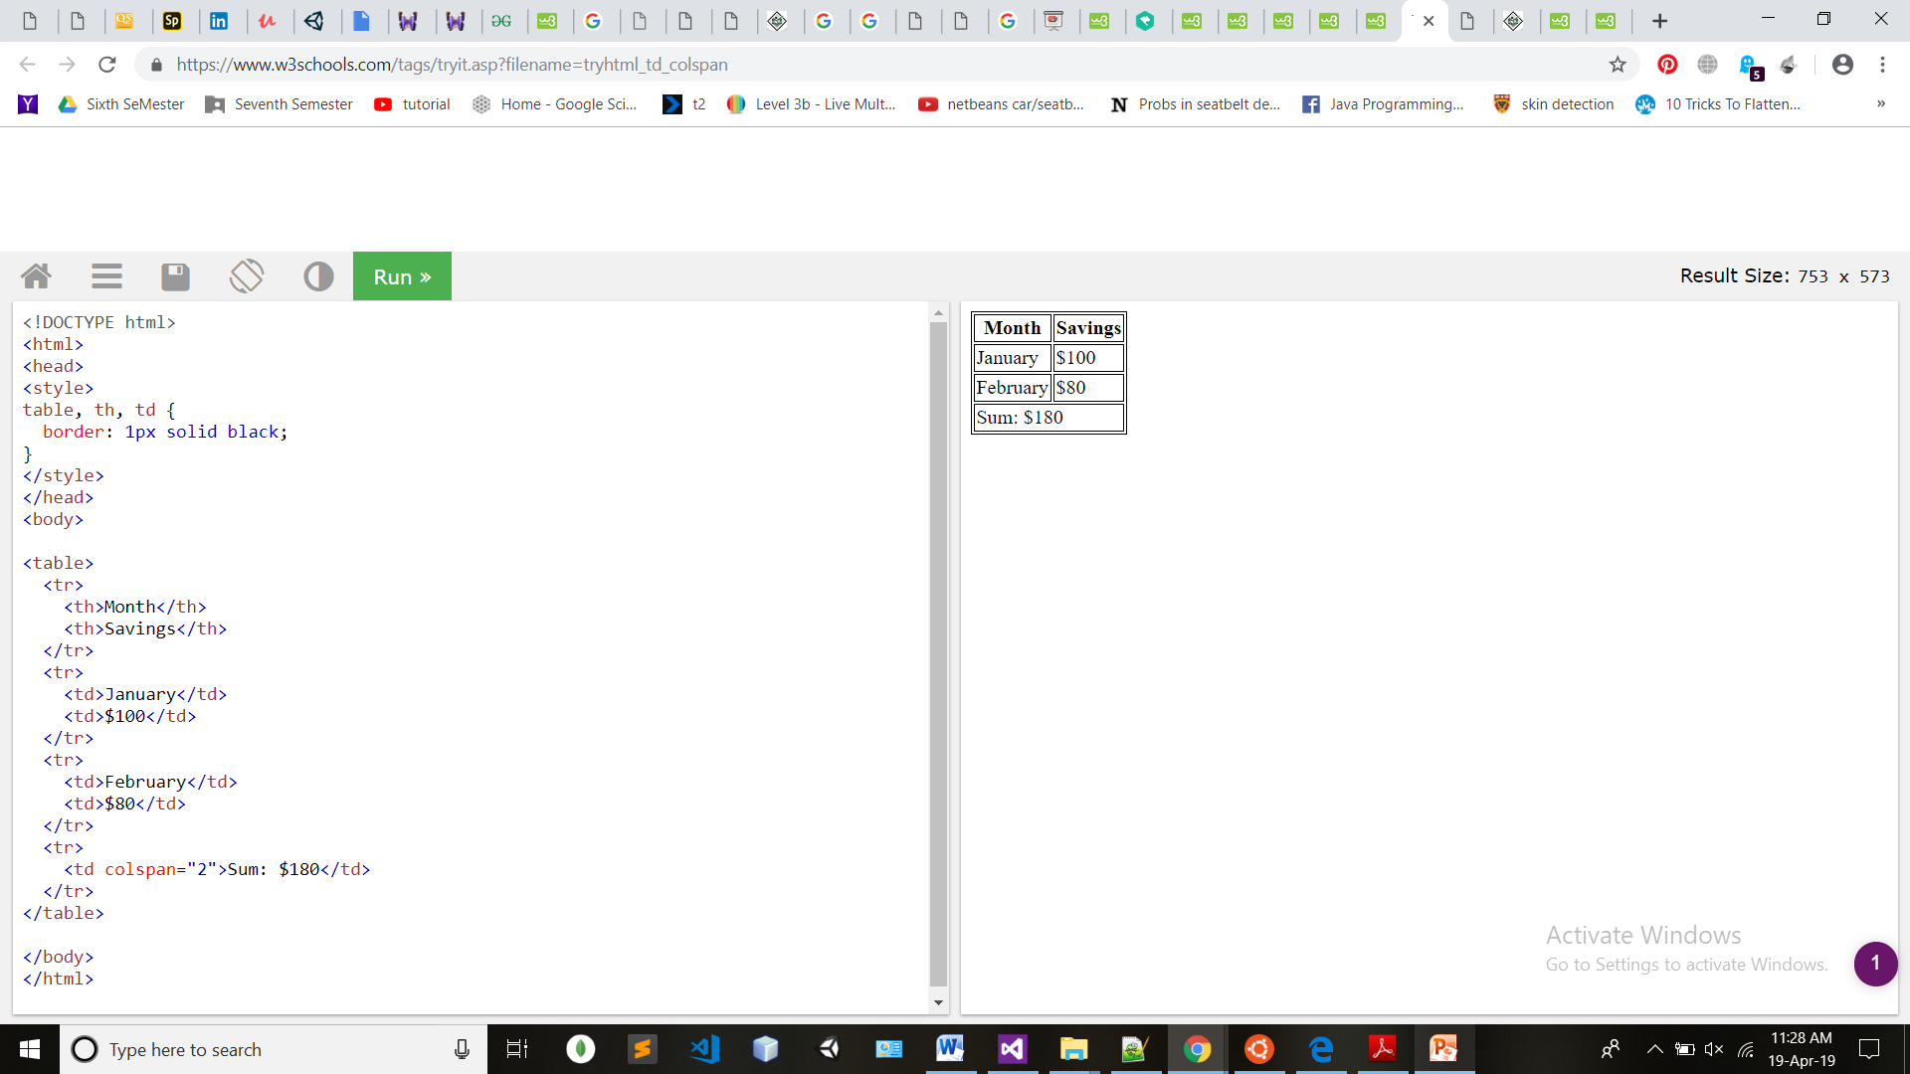
Exercise (Colspan)

Slide 18
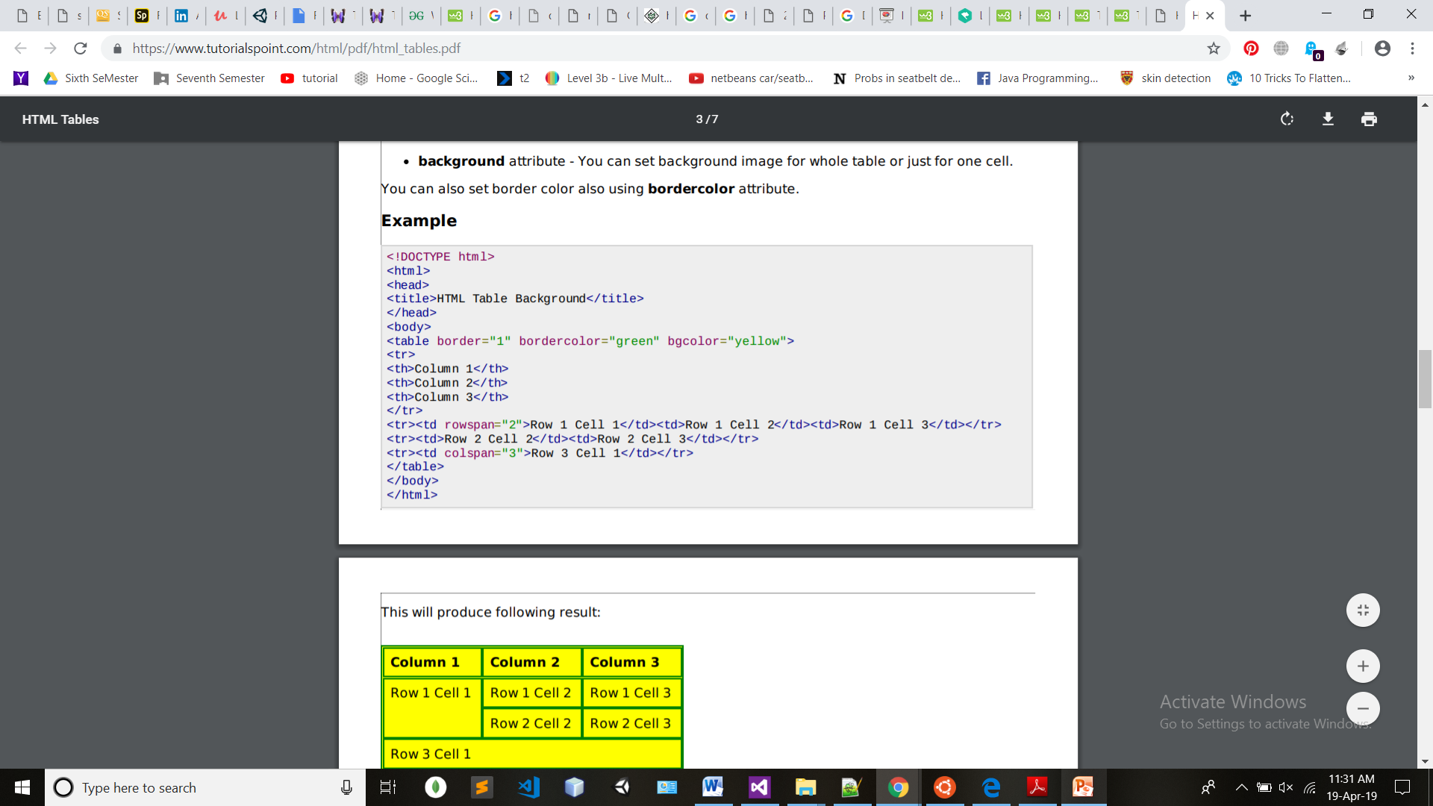
Try including

Slide 19
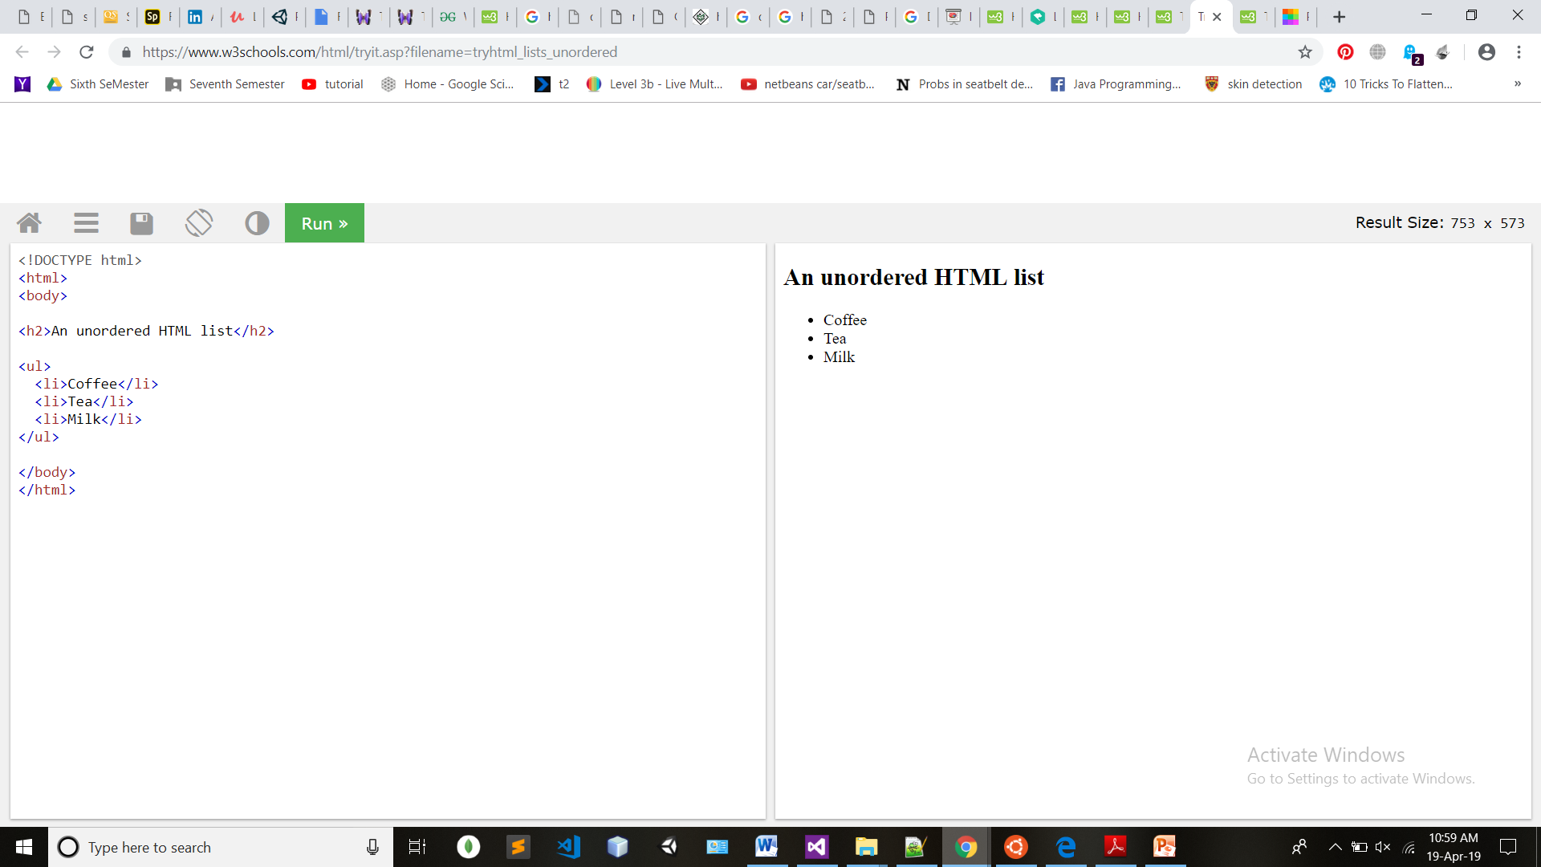
HTML Lists
<ul> − An unordered list. This will list items using plain bullets.
<ol> − An ordered list. This will use different schemes of numbers to list your items.
<dl> − A definition list. This arranges your items in the same way as they are arranged in a dictionary.

Slide 20
Type Attributes
<ul type=“circle”>
<ul type=“square”>
<ul type=“disk”>
<ol type=“1”>
<ol type=“I”>
<ol type=“i”>
<ol type=“A”>
<ol type=“a”>

Slide 21
HTML Links
A link is specified using HTML tag <a>.
This tag is called anchor tag and anything between the opening <a> tag and the closing </a> tag becomes part of the link.

Slide 22
HTML block
The <div> tag
Used for grouping of various HTML elements.
HTML font

